Slide 1

Pester – Not Just for Code
Using Assertions to Test Endpoints

Slide 2
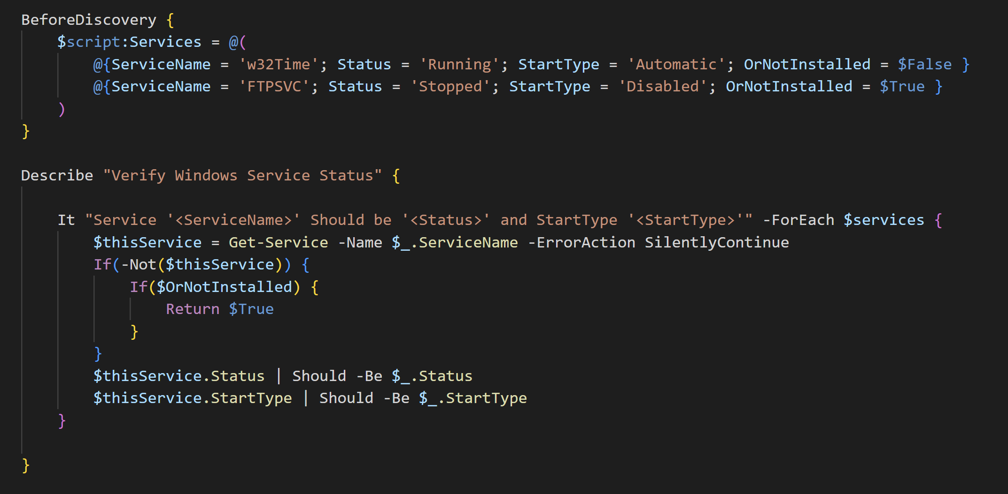
u Write Your Tests

Slide 3
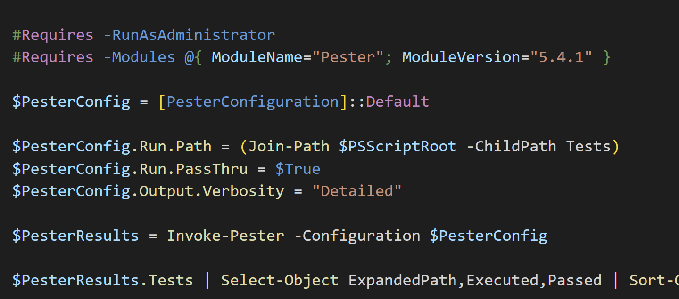
v Call Your Tests

Slide 4
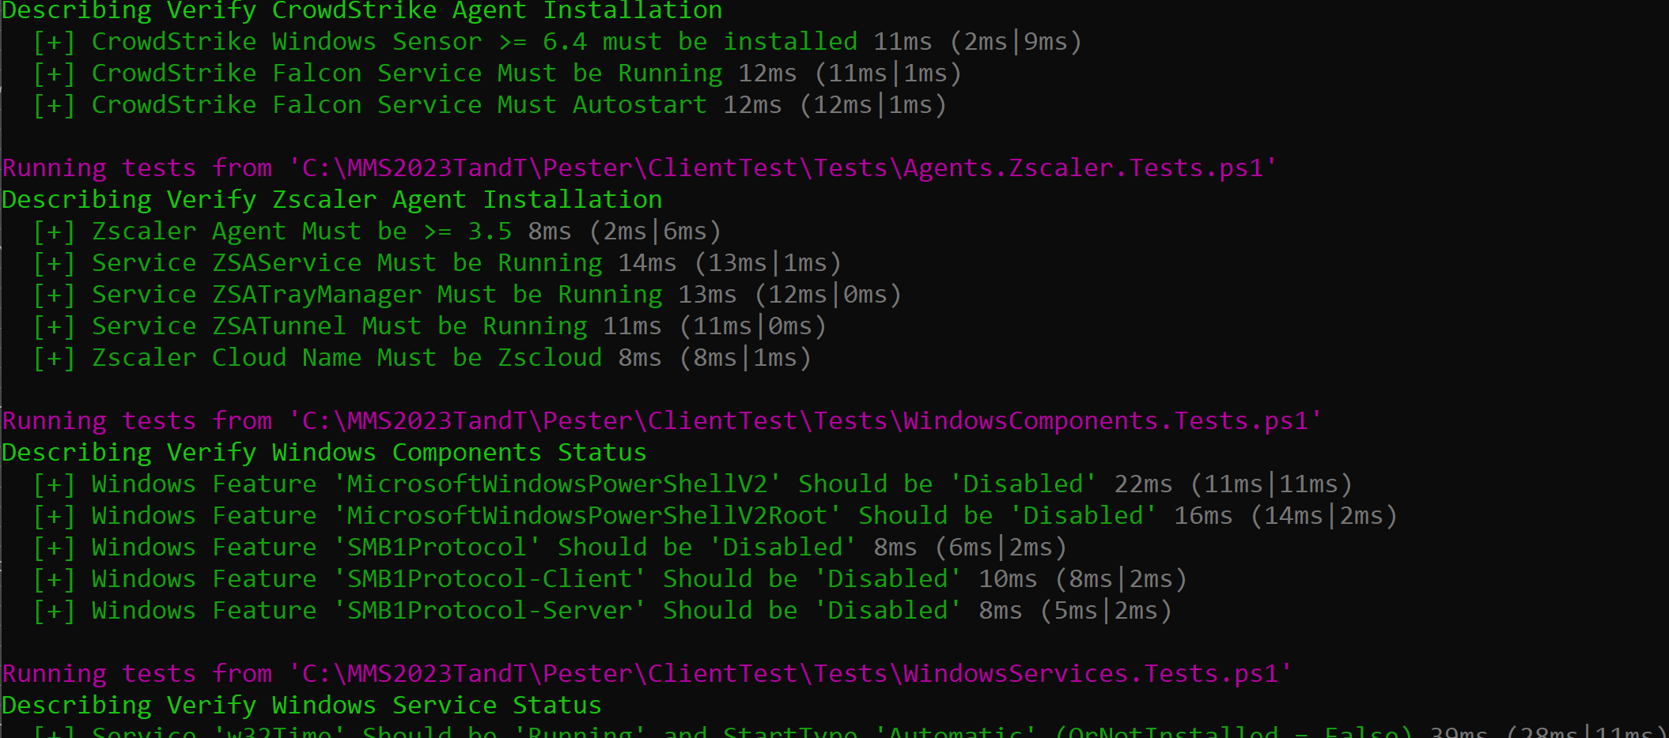
w View the Test Output

Slide 5
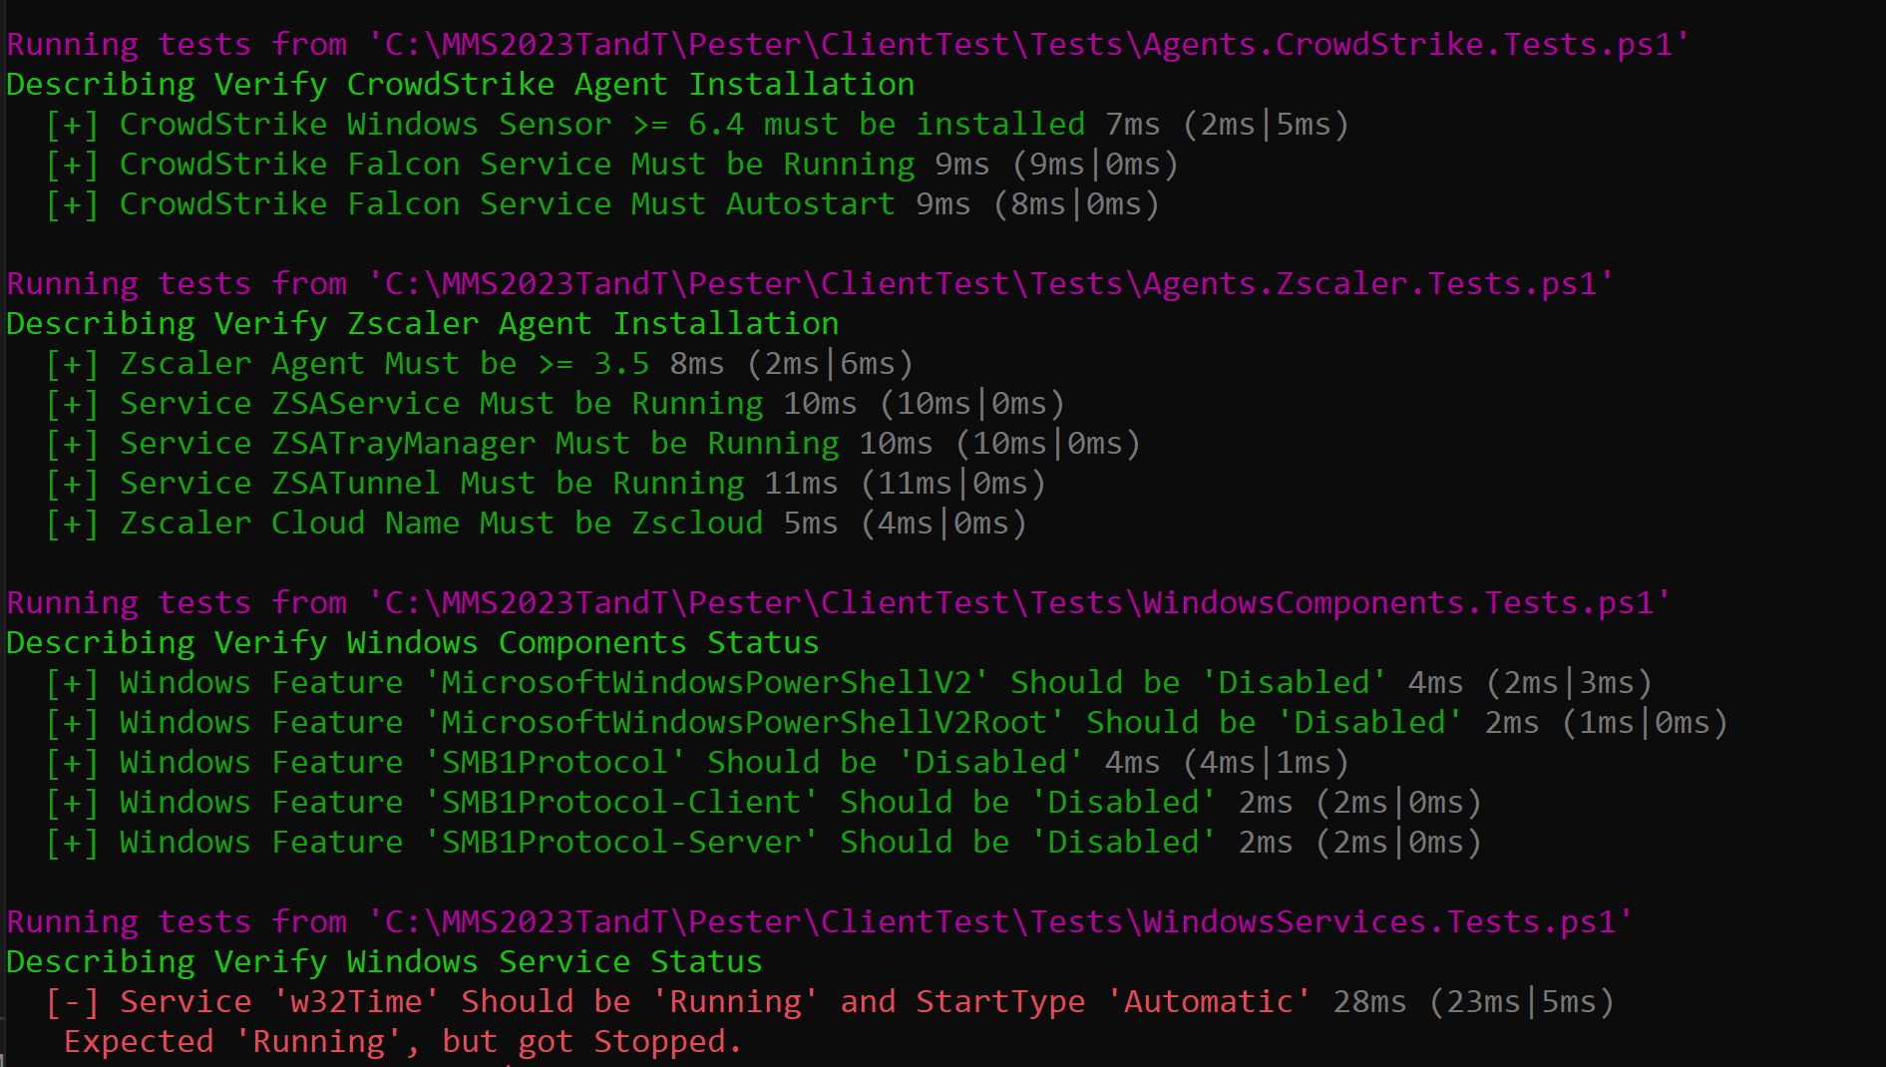
w View the Test Output (with a Failure Example)

Slide 6
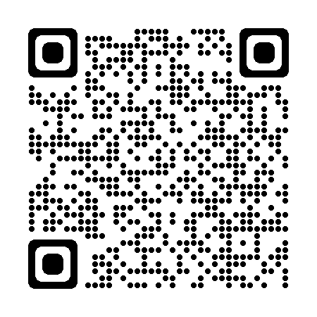
Why Pester?
It’s Free!
What could I be testing for?
Critical Agent Installation and Configuration.
You already know PowerShell.
Specific policies you expect to be configured a certain way.
Did someone reinstall PowerShell v2? SMBv1? Did an application disable your 3rd party AV?
When should I test?
Anytime you make a major change (we test as part of monthly patching)
Regularly to ensure someone didn’t accidently muck with one of your policies!
Sample Code:
https://github.com/ChrisKibble/MMS2023

